Slide 1
My Shape and Angles
Interactive Notebook
Name
Class
Term 3 Semester 2

Slide 2
Contents
Formula Page
Page
Date
Description
2
3

Slide 3
Tasks
24
7
30
Essential Question
Questions
Notes
Summary
14
15

Slide 4
24
7
30
Date
Quadrilaterals
Describe the similarities and differences between the different types of quadrilaterals?
15

Slide 5
Task 1 - Can you name any quadrilaterals?
14

Slide 6
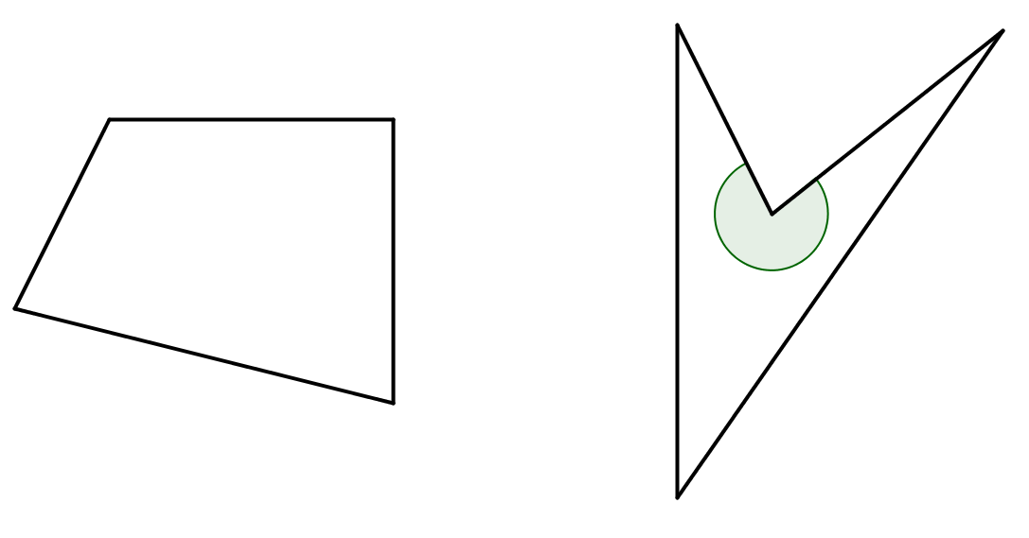
24
7
30
Date
Quadrilaterals
Describe the similarities and differences between the different types of quadrilaterals?
A quadrilateral is a 4 sided shape
Concave – one reflex interior angles
Convex – all interior angles
15

Slide 7
24
7
30
Date
Quadrilaterals
Describe the similarities and differences between the different types of quadrilaterals?
A quadrilateral is a 4 sided shape
Concave – one reflex interior angles
Convex – all interior angles
Types of quadrilaterals –
Square
Rectangle
Trapezium
Parallelogram
Rhomabus
Kite
15

Slide 8
Task 2 – Copy and complete
 | Properties
Quadrilateral |  | Side Lengths | Parallel sides | Angles | Diagonal Length | Angles at the diagonals
 | Square
 | Rectangle
 | Kite
 | Parallelogram
 | Trapezium
 | Rhombus
14

Slide 9
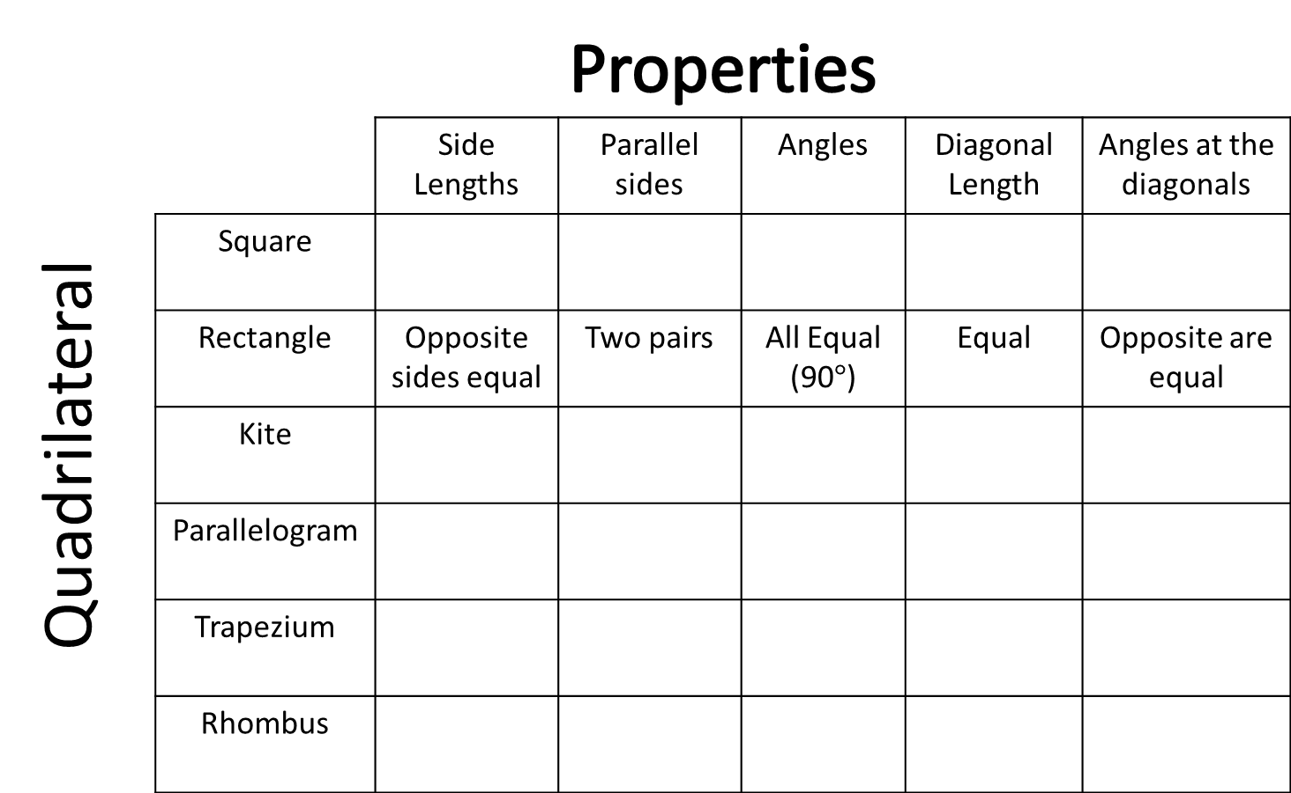
Task 2 – Copy and complete
 | Properties
Quadrilateral |  | Side Lengths | Parallel sides | Angles | Diagonal Length | Angles at the diagonals
 | Square
 | Rectangle | Opposite sides equal | Two pairs | All Equal (90$°$) | Equal | Opposite are equal
 | Kite
 | Parallelogram
 | Trapezium
 | Rhombus
14

Slide 10
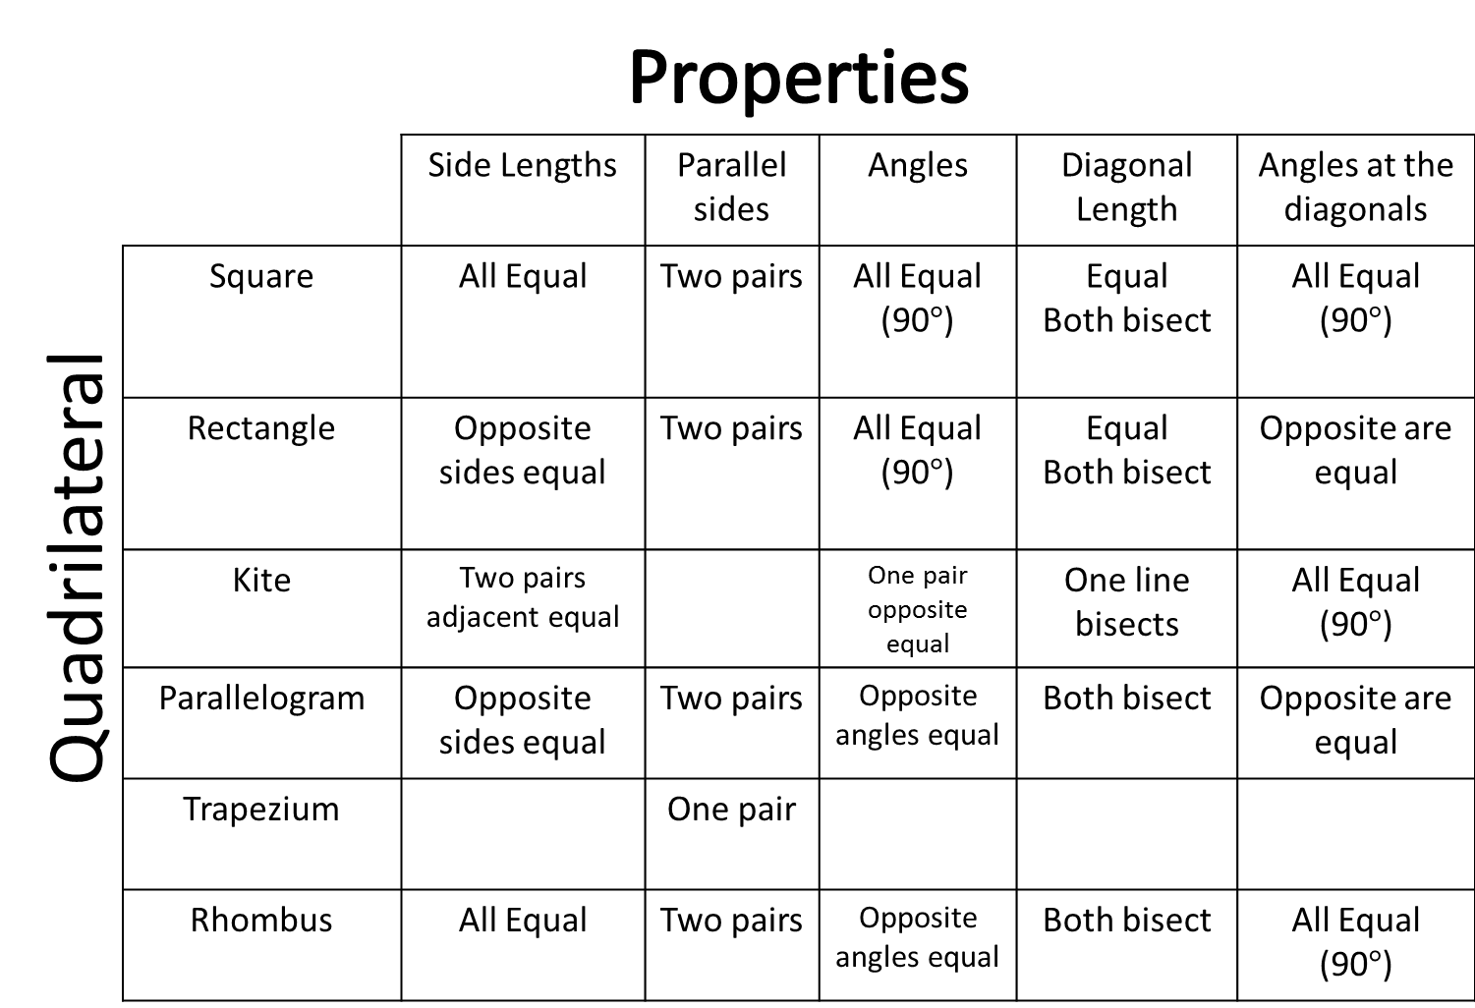
Task 2 – Copy and complete
 | Properties
Quadrilateral |  | Side Lengths | Parallel sides | Angles | Diagonal Length | Angles at the diagonals
 | Square | All Equal | Two pairs | All Equal (90$°$) | Equal Both bisect | All Equal (90$°$)
 | Rectangle | Opposite sides equal | Two pairs | All Equal (90$°$) | Equal Both bisect | Opposite are equal
 | Kite | Two pairs adjacent equal |  | One pair opposite equal | One line bisects | All Equal (90$°$)
 | Parallelogram | Opposite sides equal | Two pairs | Opposite angles equal | Both bisect | Opposite are equal
 | Trapezium |  | One pair
 | Rhombus | All Equal | Two pairs | Opposite angles equal | Both bisect | All Equal (90$°$)
14

Slide 11
24
7
30
Date
Quadrilaterals
Describe the similarities and differences between the different types of quadrilaterals?
Types of quadrilaterals –
Square
Rectangle
Trapezium
Parallelogram
Rhomabus
Kite
Adjacent – next to
Bisect – split in two
15

Slide 12
24
7
30
Date
Quadrilaterals
Describe the similarities and differences between the different types of quadrilaterals?
Adjacent – next to
Bisect – split in two
Types of quadrilaterals –
Square
Rectangle
Trapezium
Parallelogram
Rhomabus
Kite
A square is also a rectangle, parallelogram and rhombus
A rhombus is also a parallelogram
A rectangle is also parallelogram
A rhombus is also a kite
15

Slide 13
Questions

Slide 14
Notes Review
24, 7 ,30
Date
Title
Essential question
Notes complete
Notes complete with colour and diagrams
Questions completed
Contents page filed in
Formula page filled in

Slide 15
Homework
Review your notes and write a summary answering the essential question.

